Slide 1



Modern design

Slide 2
COMPONENTS OF ai
Machine learning - This serves as a fundamental element of an AI system, allowing us to "train" a computer model to generate predictions and derive insights from data.
Computer vision - The ability of AI to understand and interpret visual information from cameras, videos, and images.
Natural language processing - A subset of AI that enables computers to comprehend and respond to written or spoken language.

Slide 3
COMPONENTS OF ai
Document intelligence - AI functionalities that focus on managing, processing, and utilizing large amounts of data found in various forms and documents.
Knowledge mining - AI capabilities that extract valuable information from extensive, often unstructured data sets to build a searchable repository of knowledge.
Generative AI - The branch of AI that is capable of producing original content across various formats, including natural language, images, code, and other mediums.

Slide 4
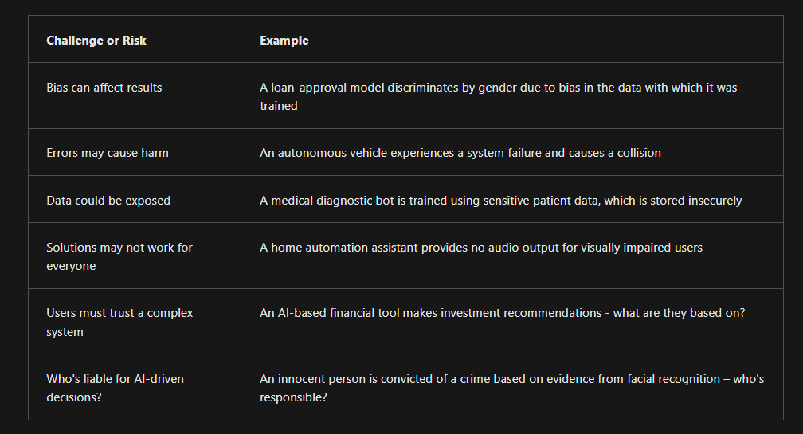
https://learn.microsoft.com/en-us/training/modules/get-started-ai-fundamentals/7-challenges-with-ai

Slide 5
How Industry worries about ethical aspects of ai
https://learn.microsoft.com/en-us/training/modules/get-started-ai-fundamentals/8a-understand-responsible-ai

Slide 6
Prompts
Who are you and what can you do?
Why is the sky blue?
When Grant was 8, his brother was half his age. Now, Grant is 14. How old is his brother?
There are three apples in the basket, and you take away 2. How many apples do you have now?
Two fathers and two sons spent the day fishing but only caught 3 fish. This was enough for each of the to have one fix. How is this possible?

Slide 7
Openwebui.com
Look at docs
How to add users: https://www.youtube.com/watch?v=DhRvV5o6SCU

Slide 8

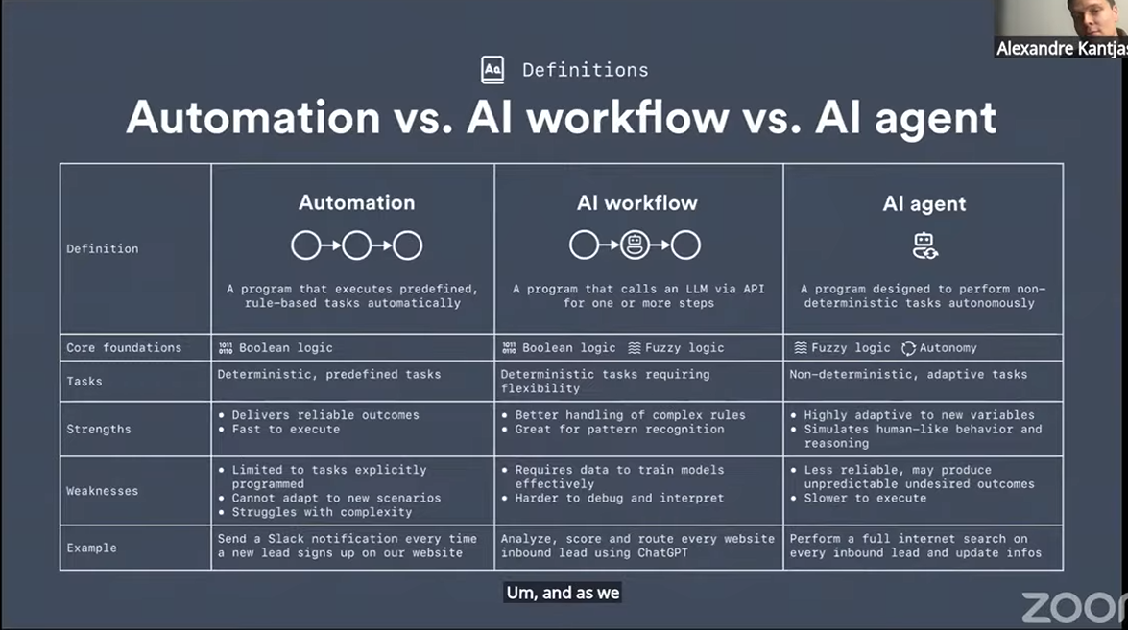

Slide 9
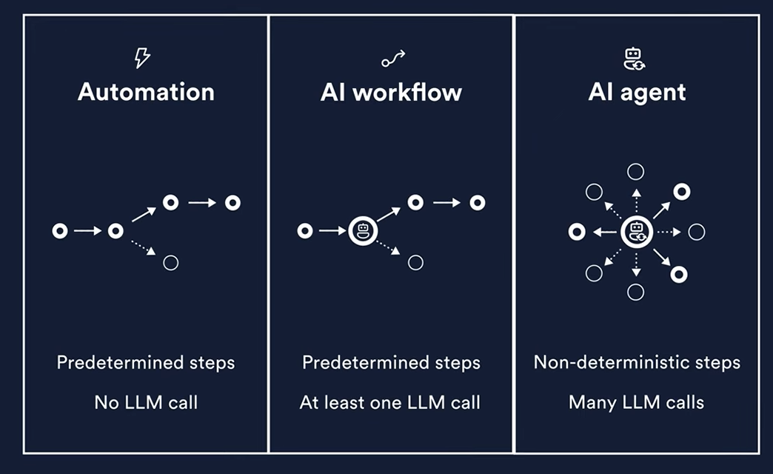

Slide 10


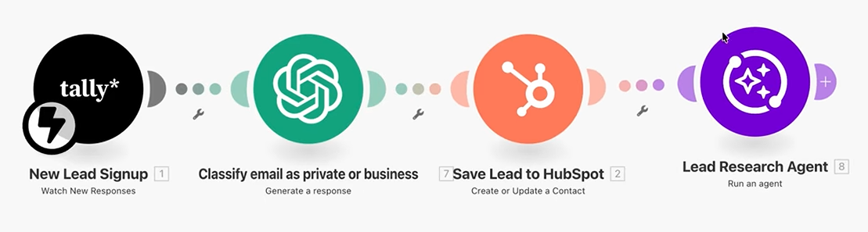
I run a business that sells running shoes. Someone goes to my website to signup for a newsletter.

Slide 11
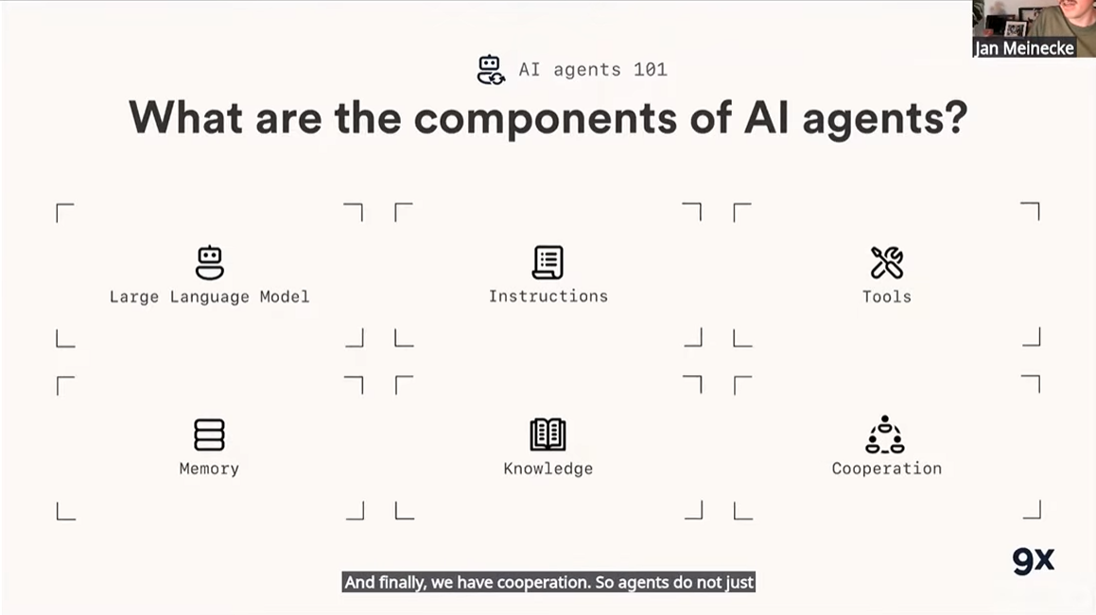

Slide 12
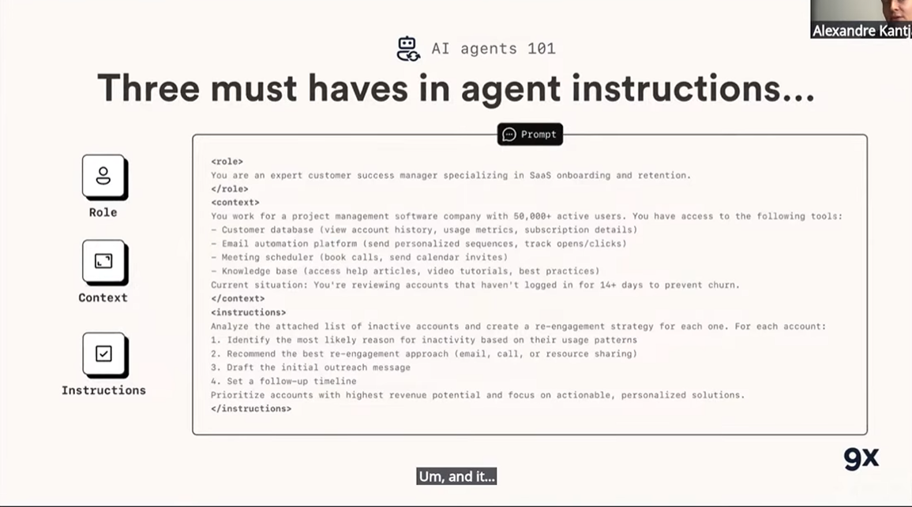

Slide 13
